Slide 1

Governance and Compliance with Microsoft Purview A getting started guide – 4 - Data Quality
If you think compliance is complicated, feel free to try incompliance!
Jan Cordtz, Snr. Cloud Solution Architect
Microsoft Denmark
Note – in this document the name Purview – if not otherwise
stated - is used for the Data Governance part of Purview.

Slide 2
Get Purview Data Governance running

Slide 3
The Purview “Process”
Installation
Establish Domains
Data Map
Unified Catalog
Establish Governance Domains
Establish Collections
Establish Data Products
Register Sources
Connect assets to Data Products -> Governed assets
Establish assets
Scan
API
Enhance assets
Descriptions (scan?)
Owners
Lineage (scan?)
Glossaries
Classification (scan?)
Sensitivity
Enhance data product
Owners
Glossaries
OKR
Critial Data elements
Data Access
Data Quality
Advanced
Api’s
Workflows
Enforcement of rights

Slide 4
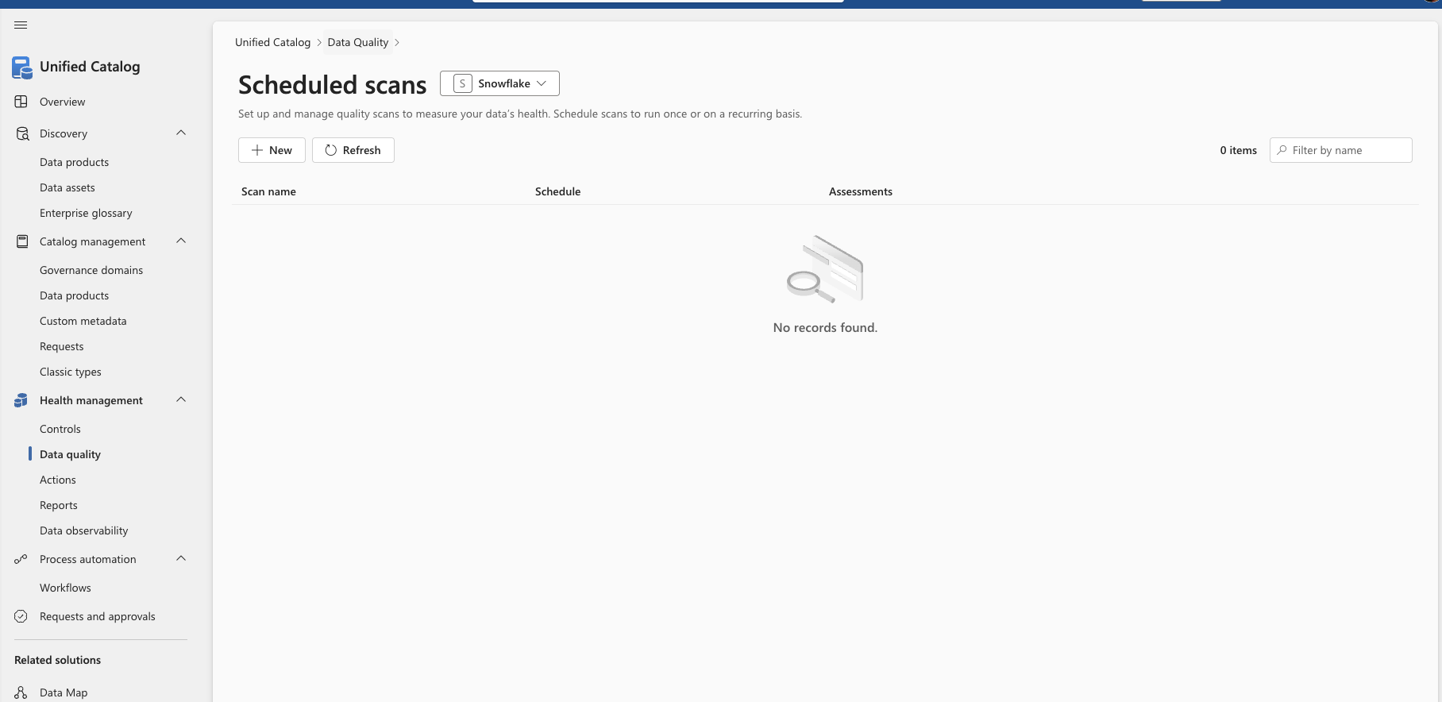

Slide 5
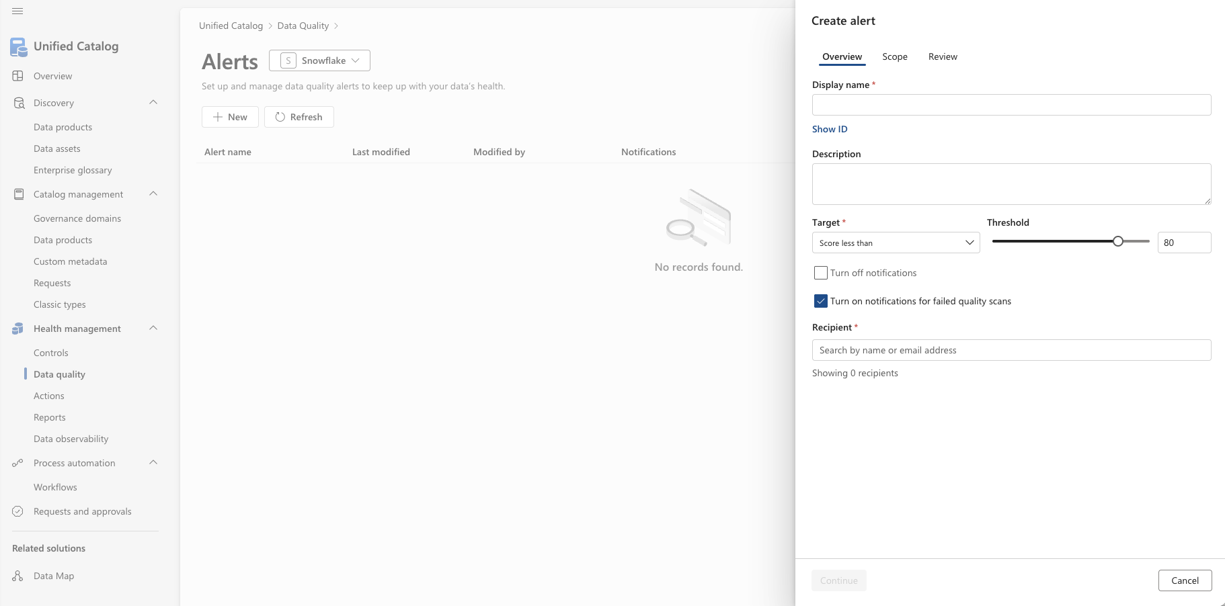

Slide 6
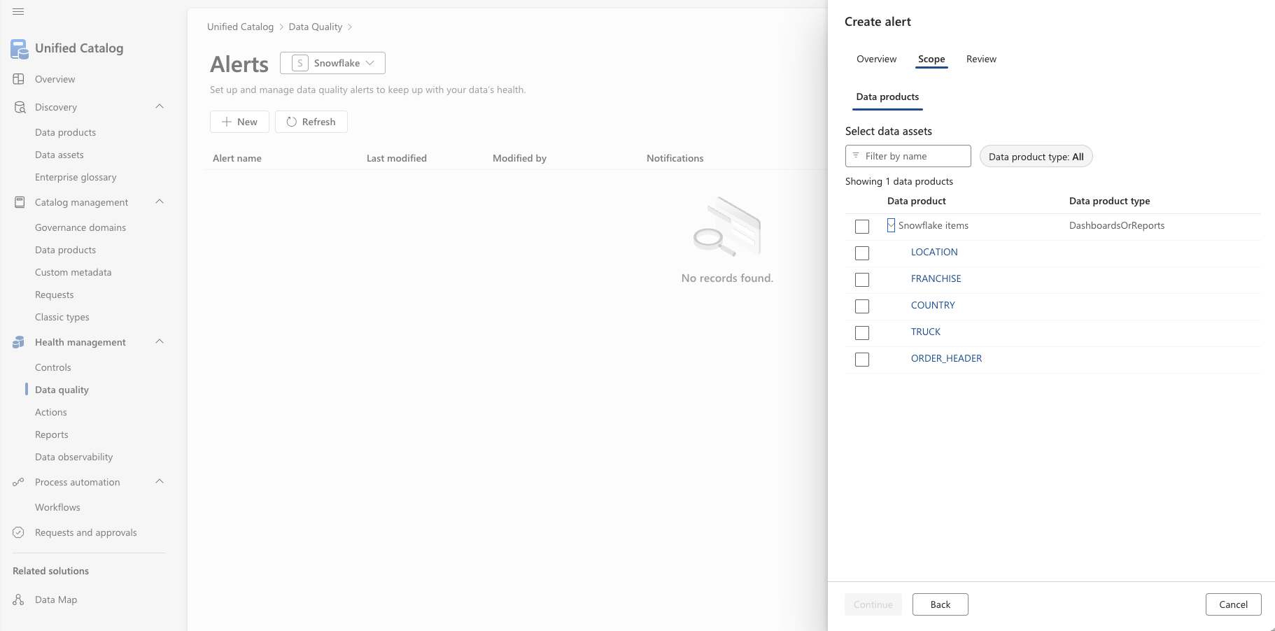

Slide 7
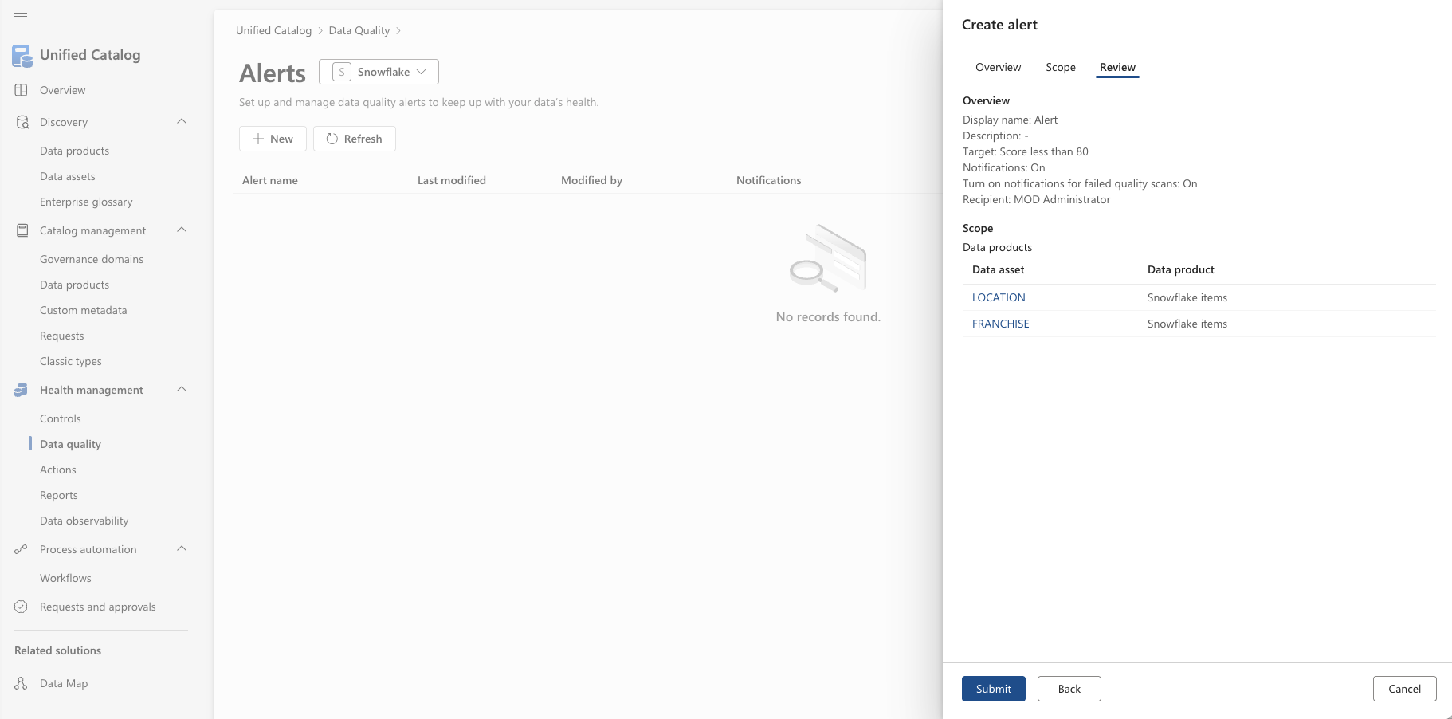

Slide 8
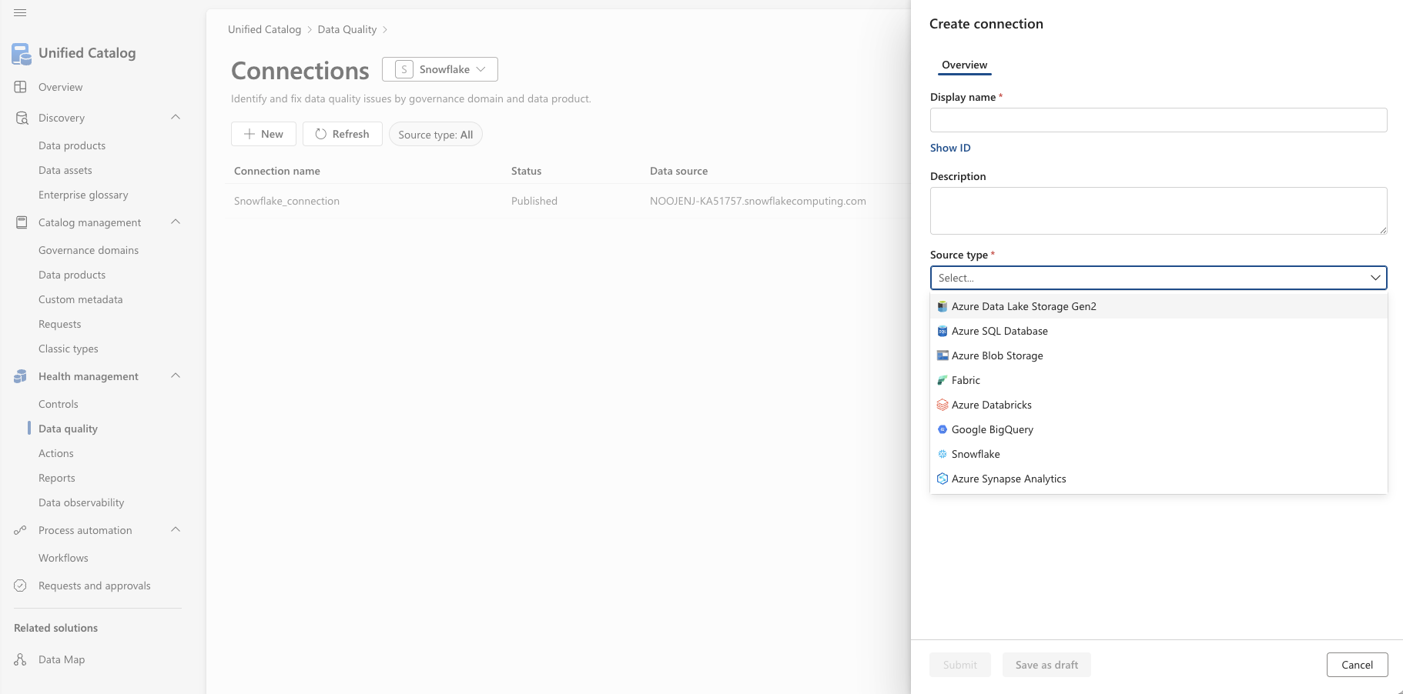

Slide 9
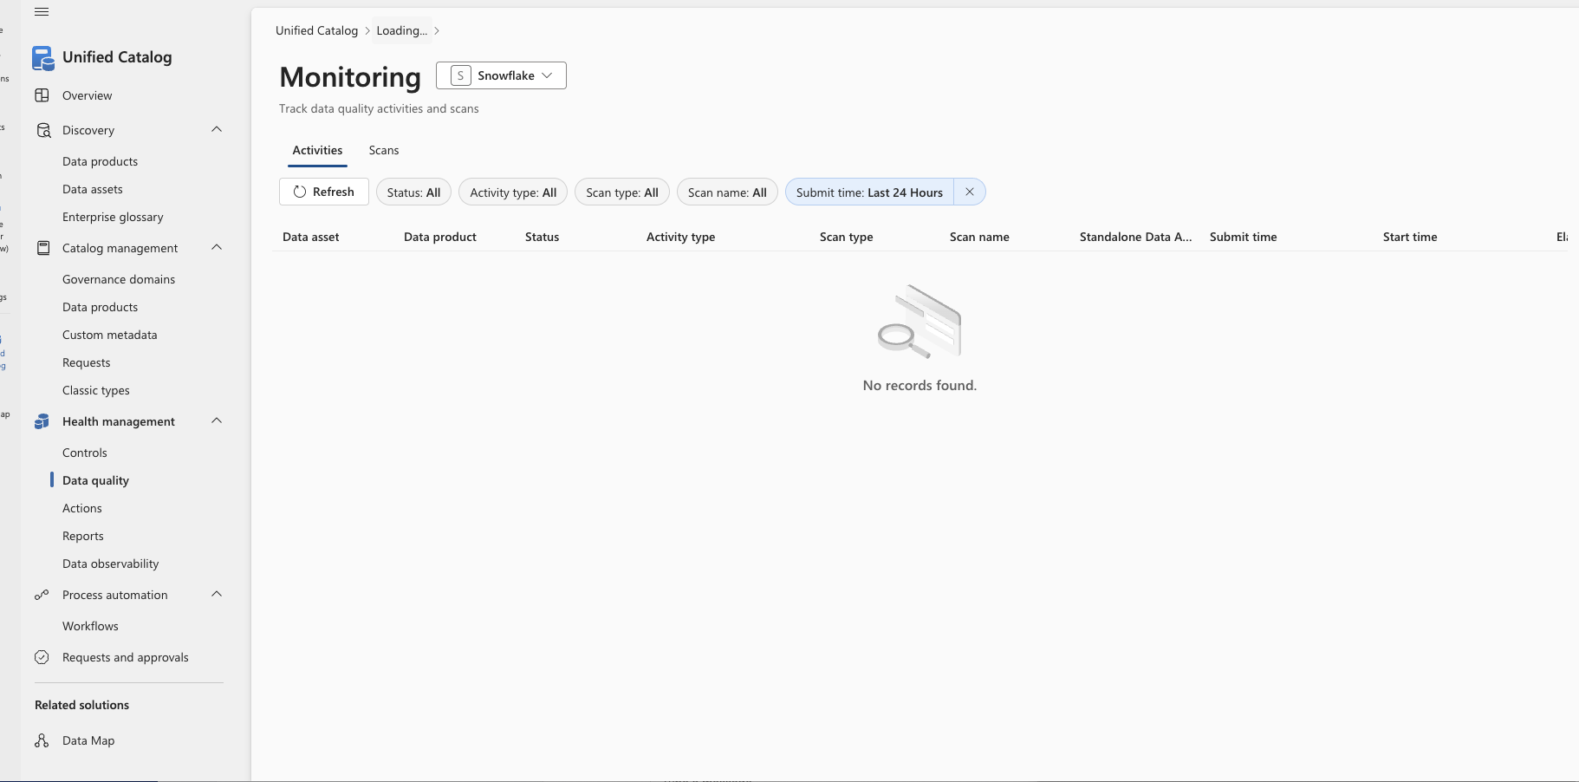

Slide 11
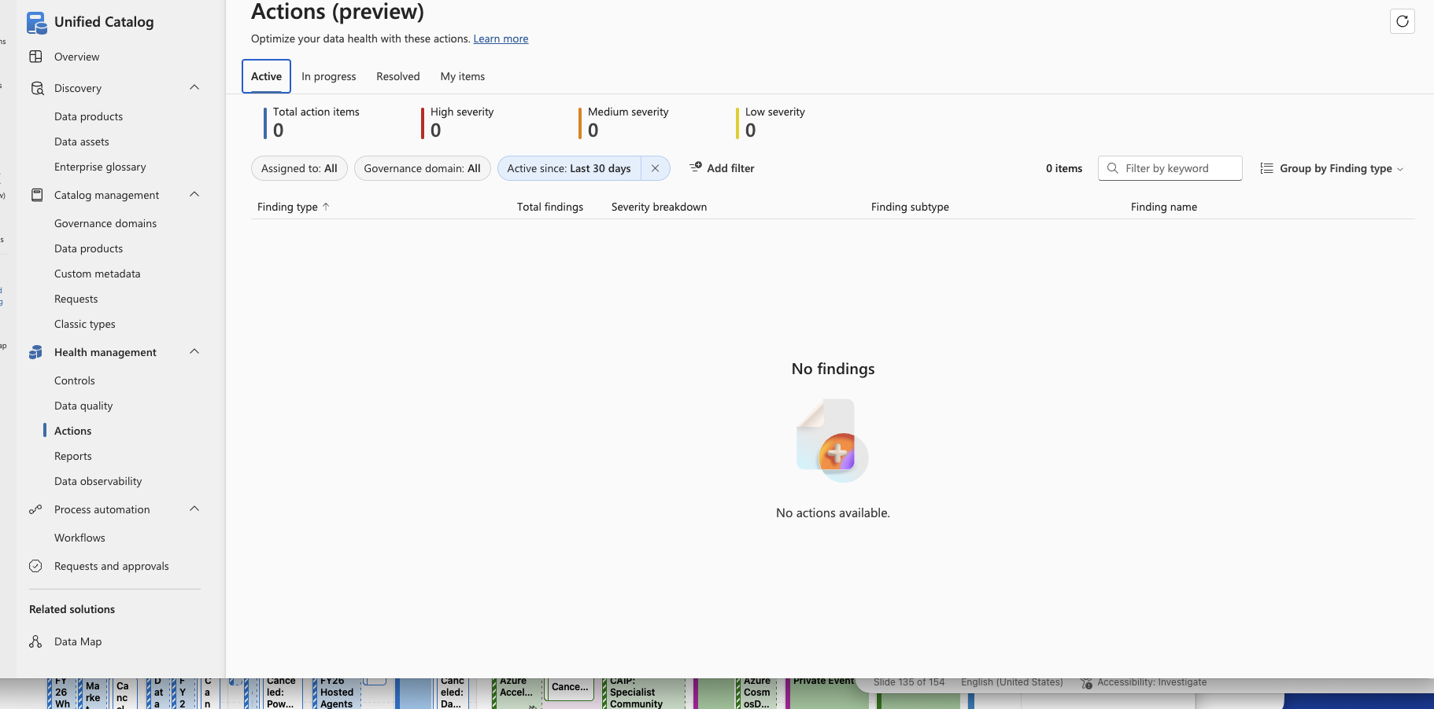

Slide 12
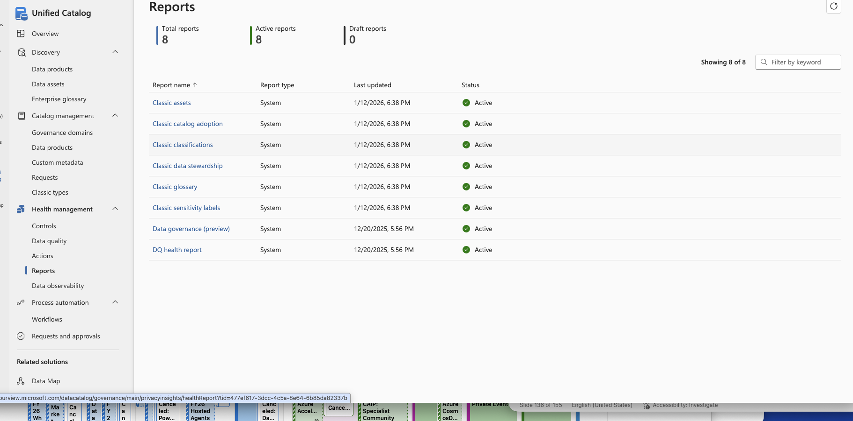

Slide 13
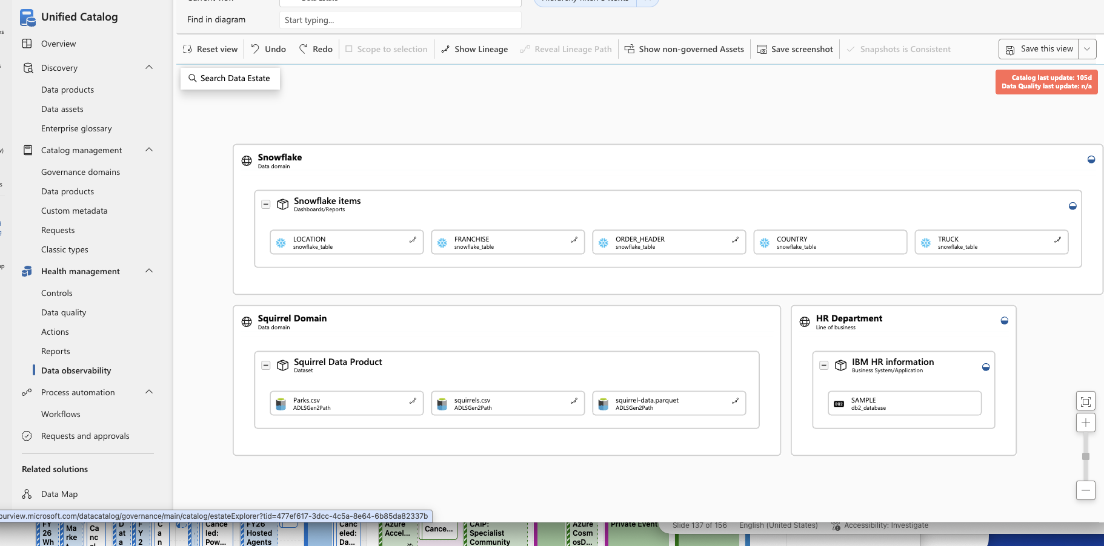

Slide 14
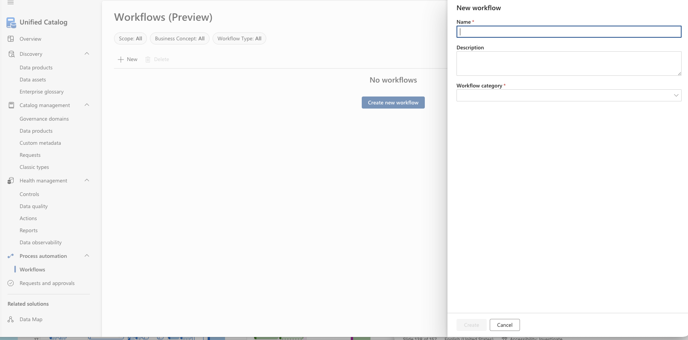

Slide 15
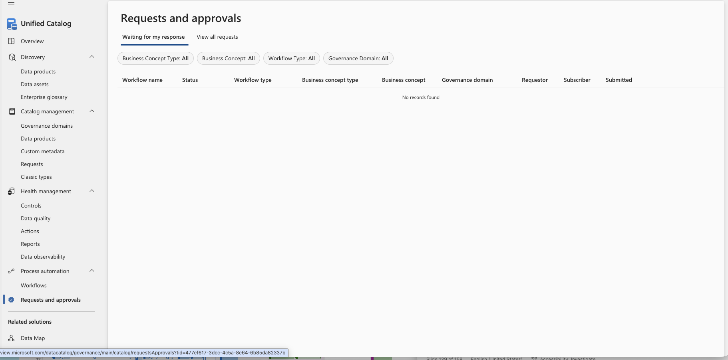

Slide 16
Health management
Data Quality

Slide 17
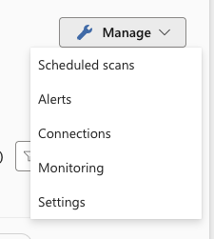
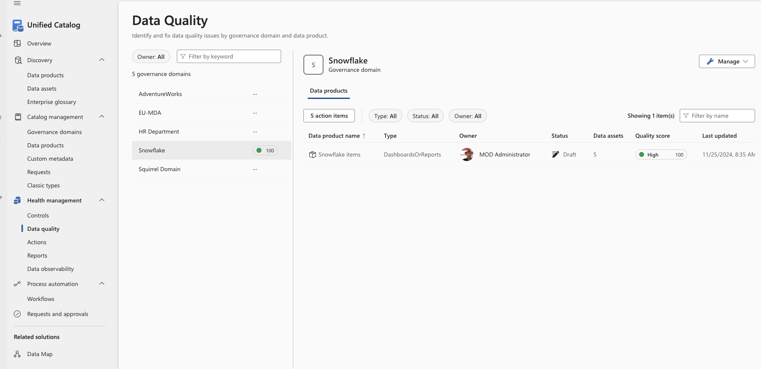

Slide 18
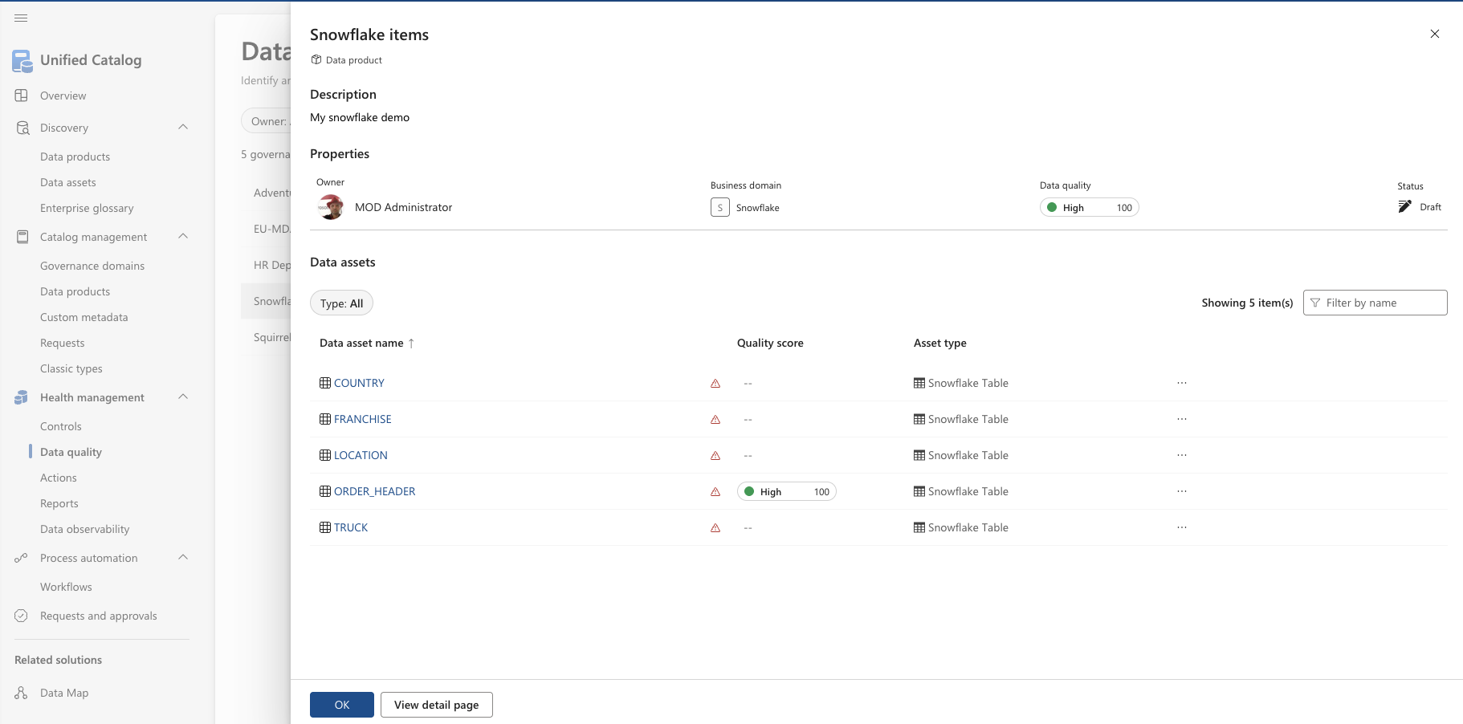

Slide 19
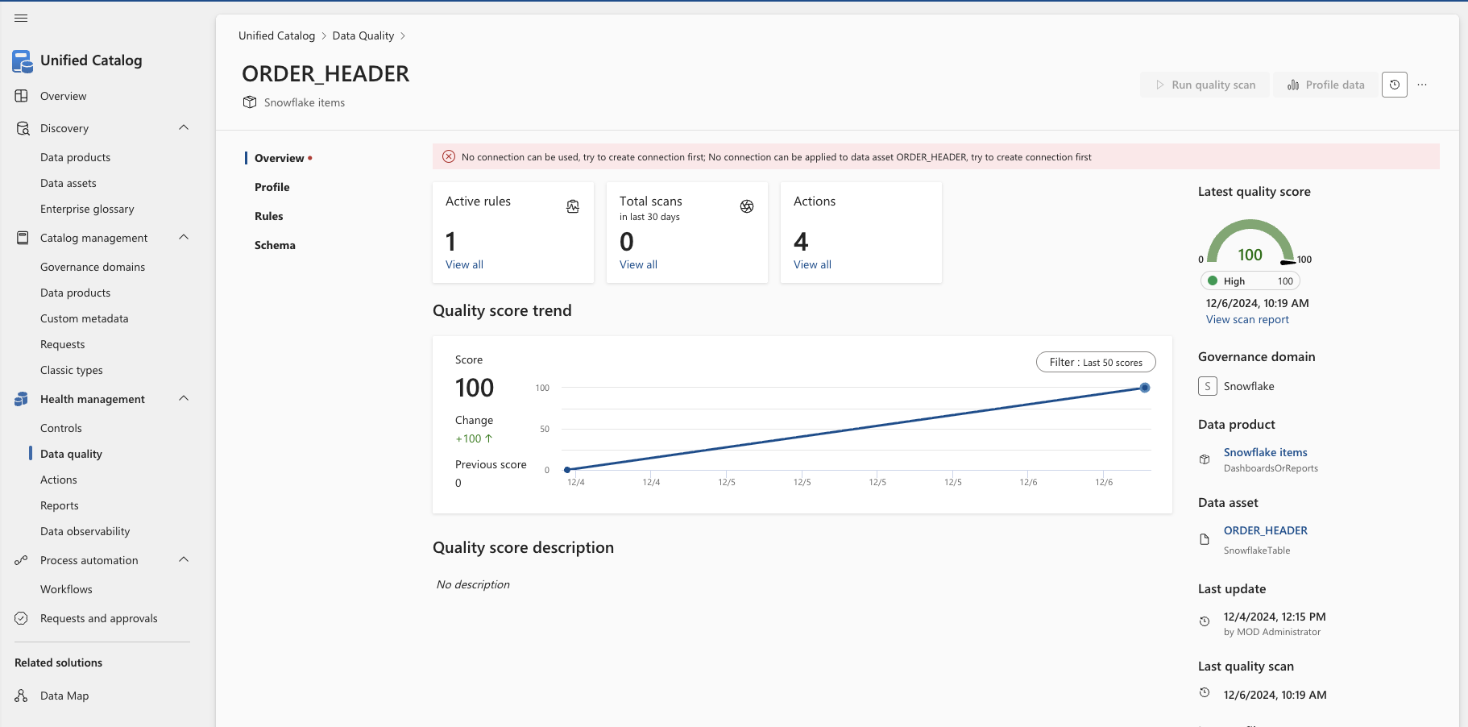

Slide 20
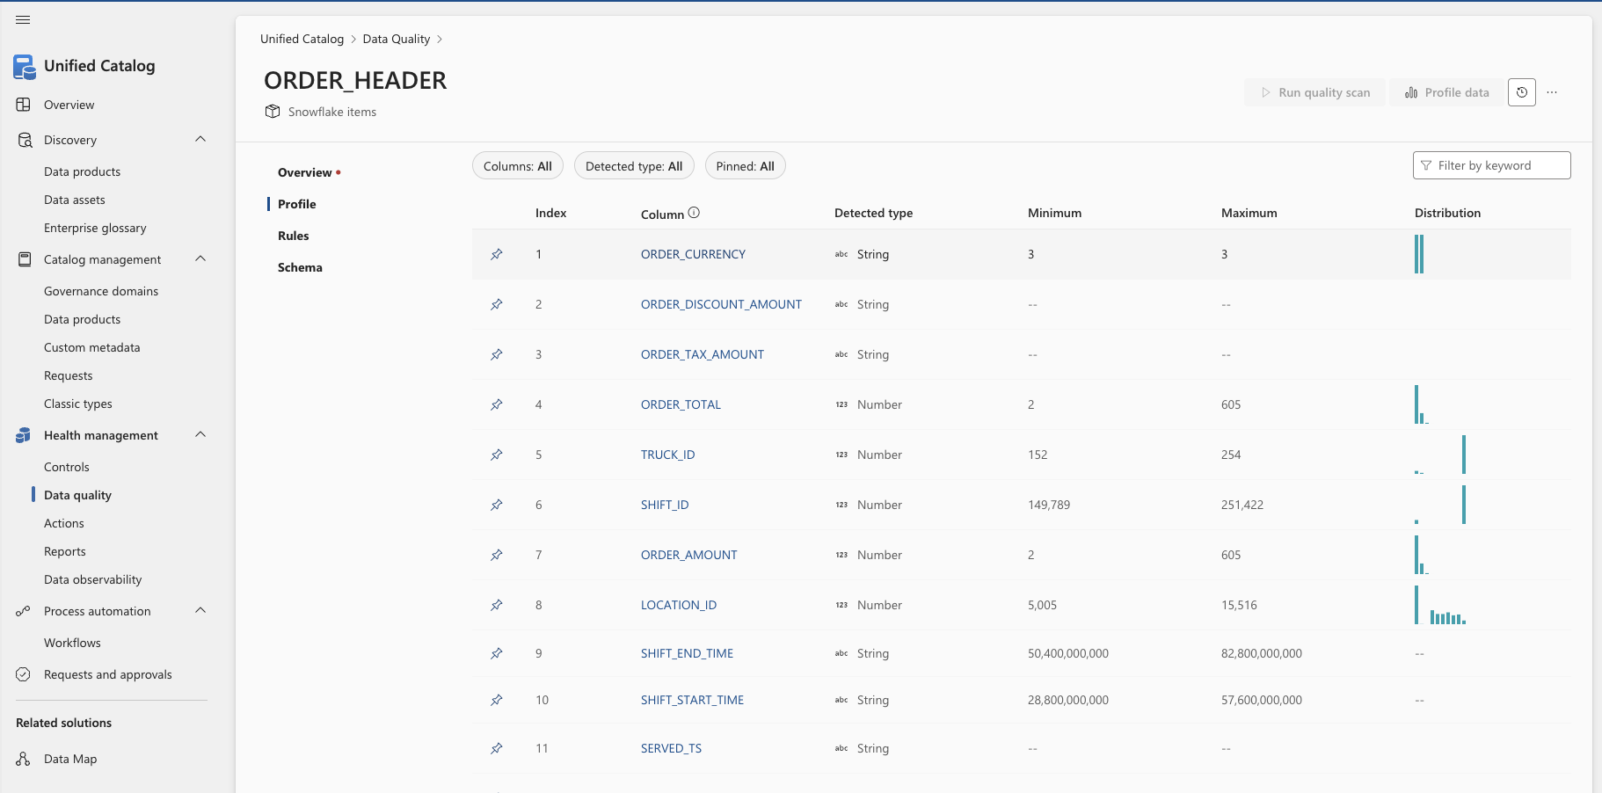

Slide 21
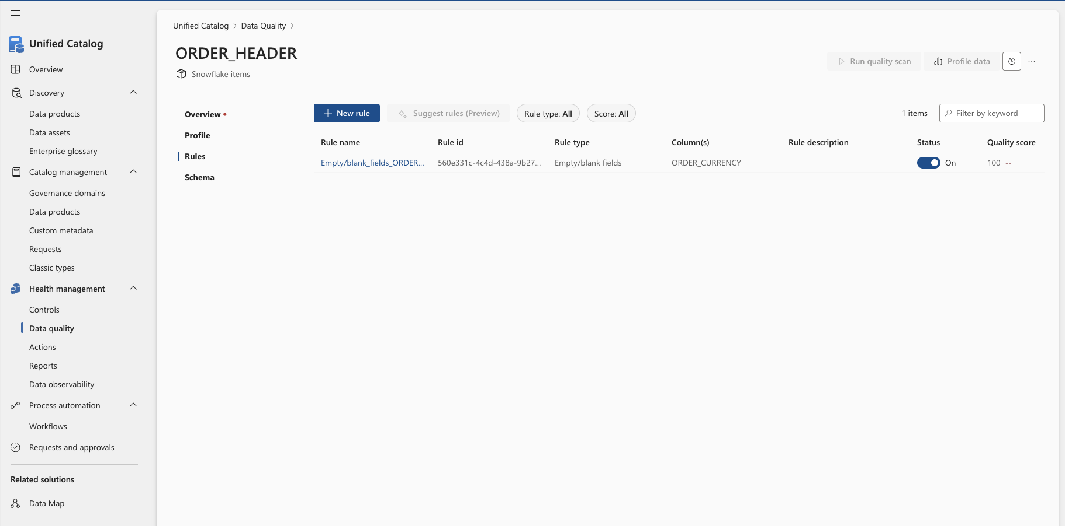

Slide 23
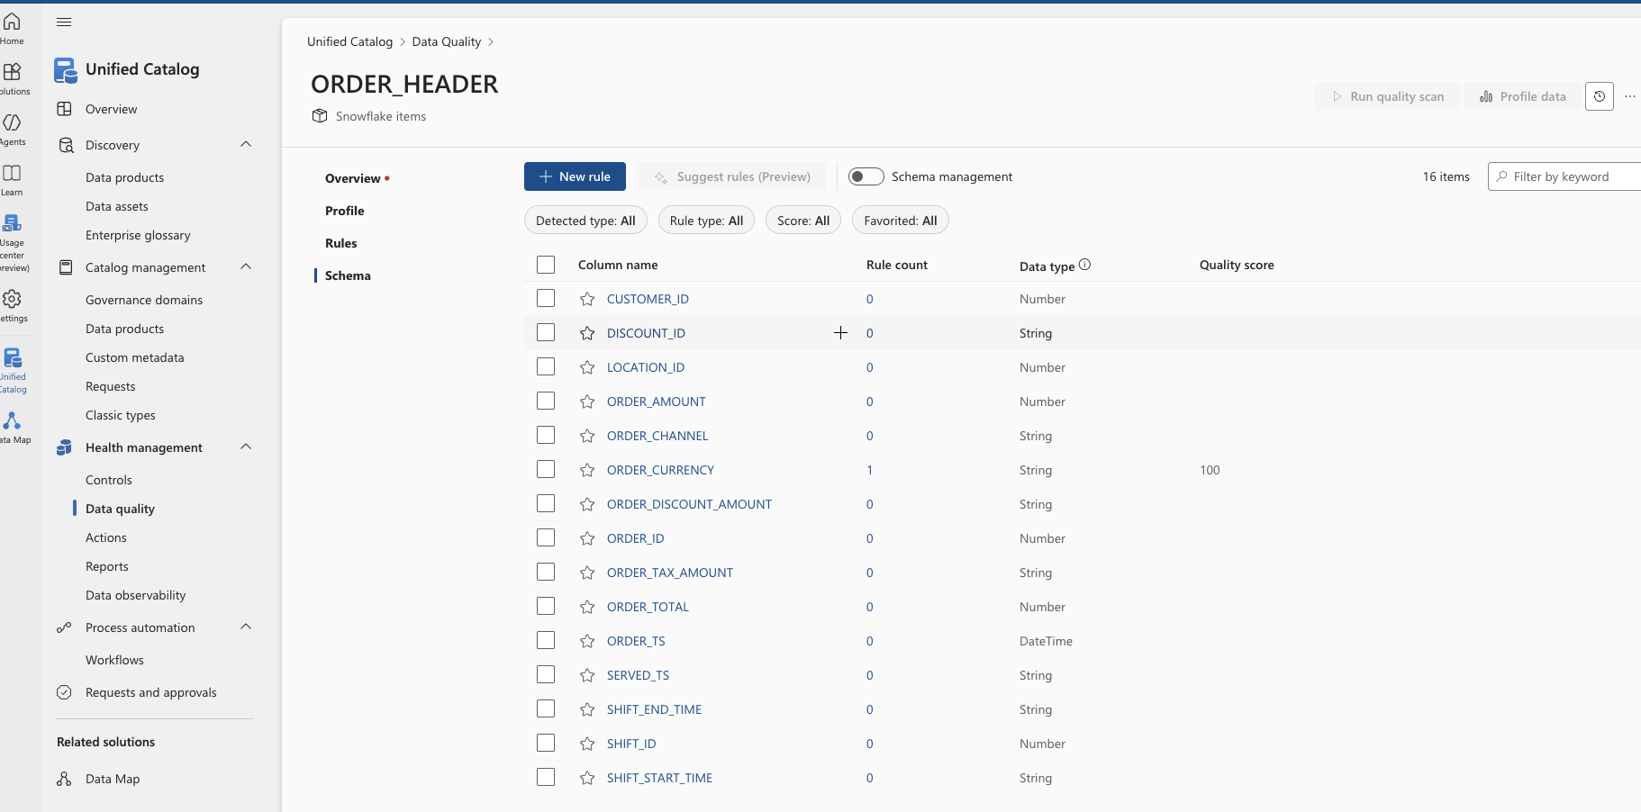

Slide 24
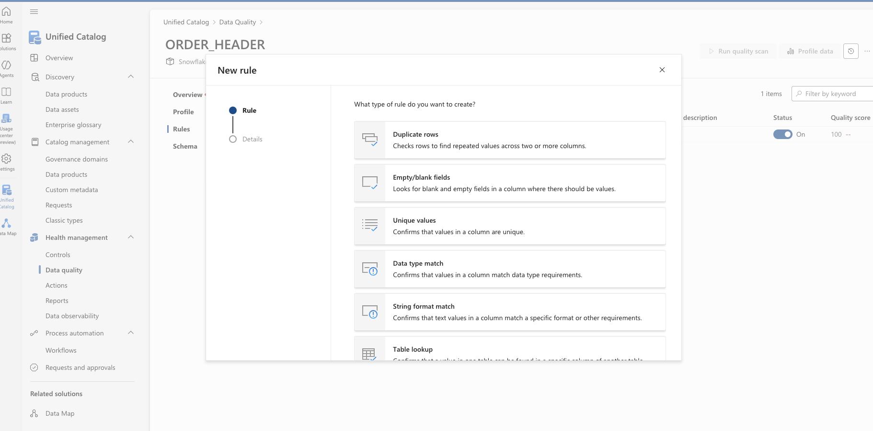

Slide 25
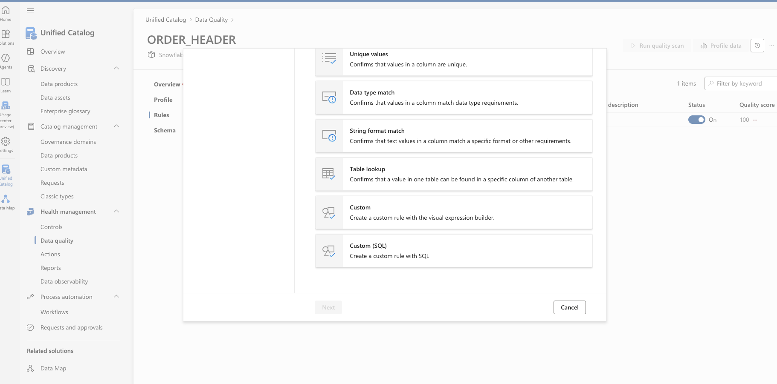

Slide 26
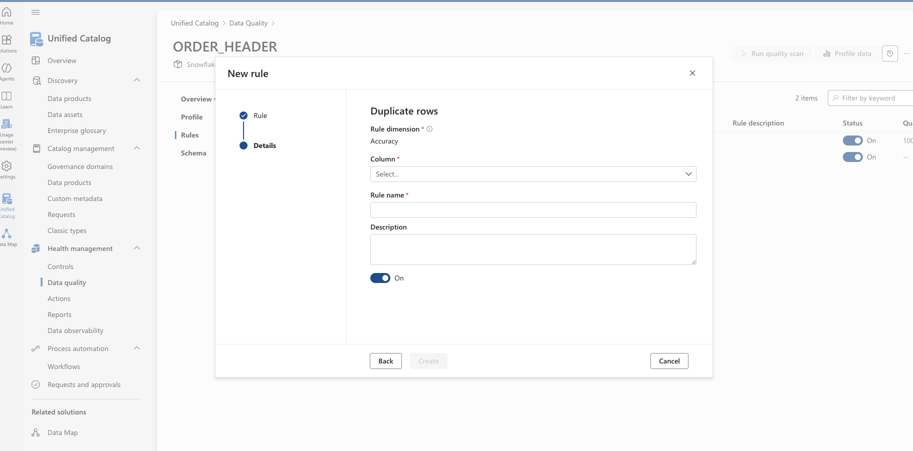

Slide 27
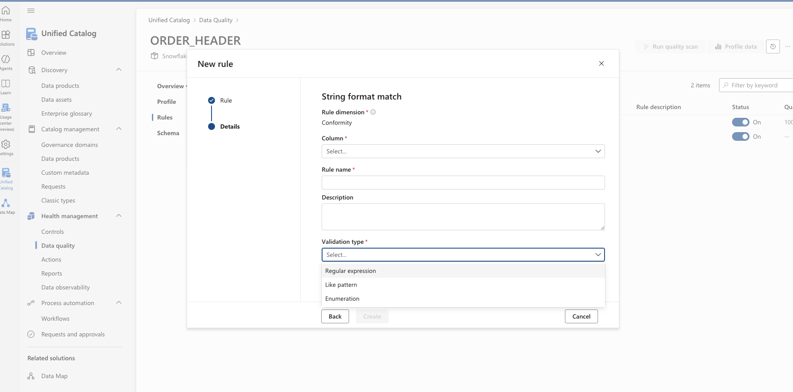

Slide 28
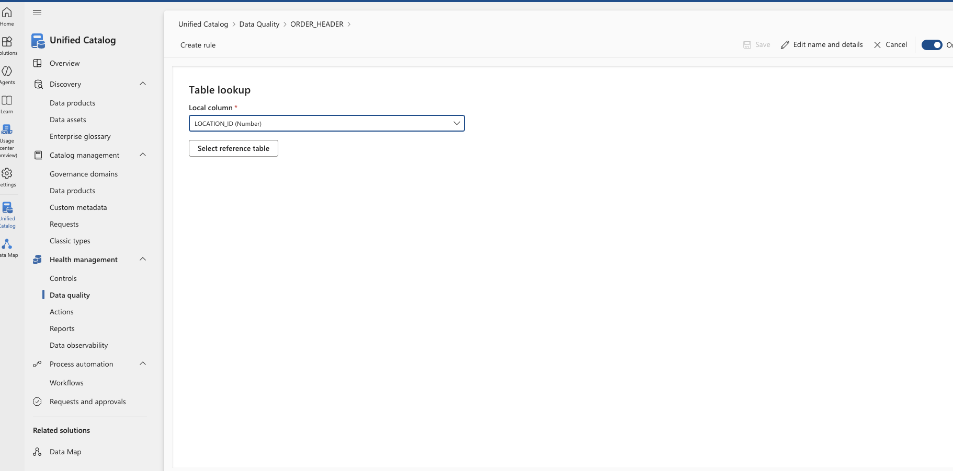

Slide 29
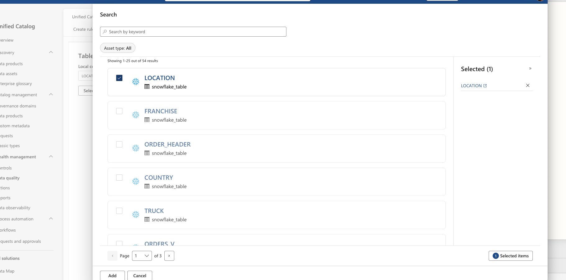

Slide 30
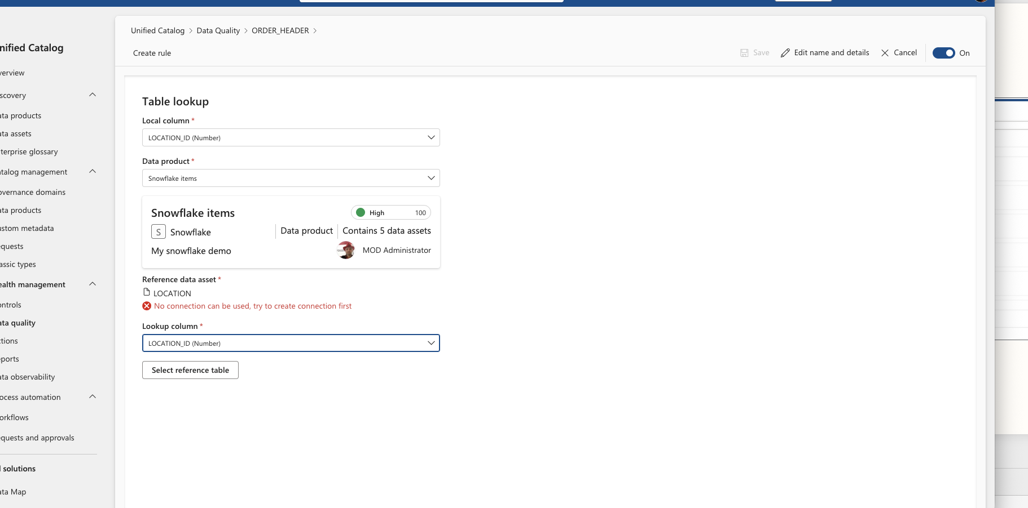

Slide 31
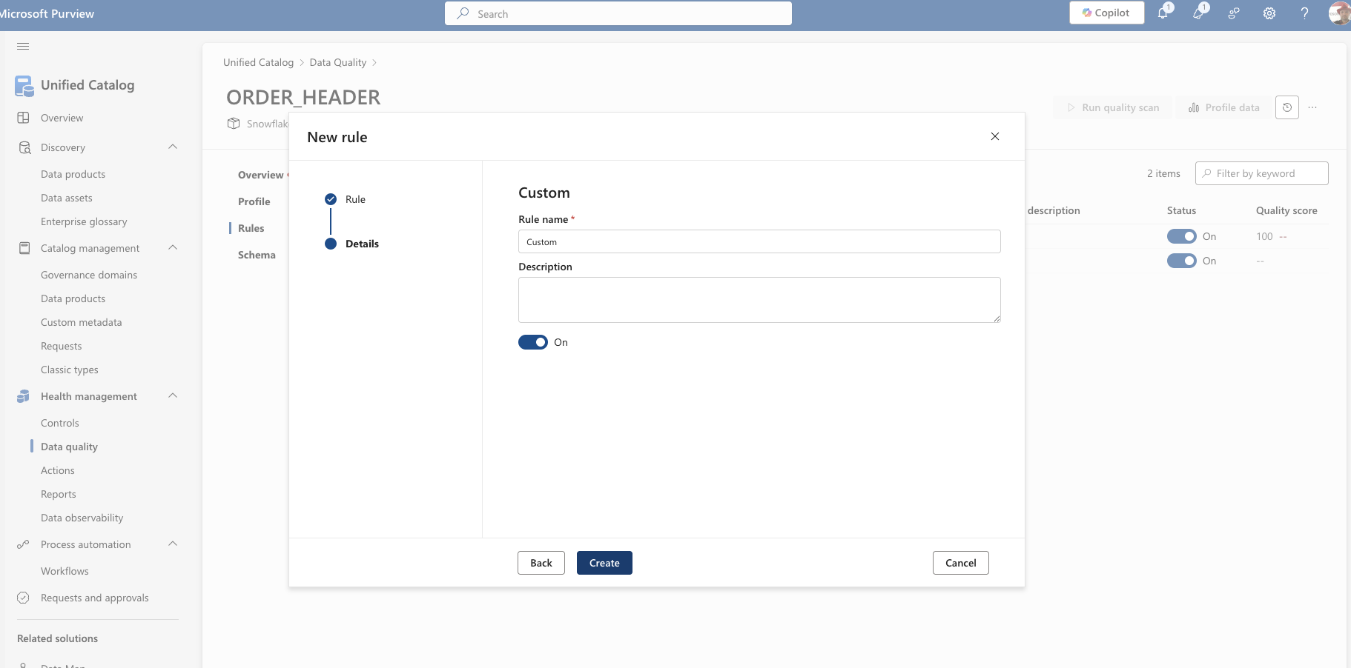

Slide 32
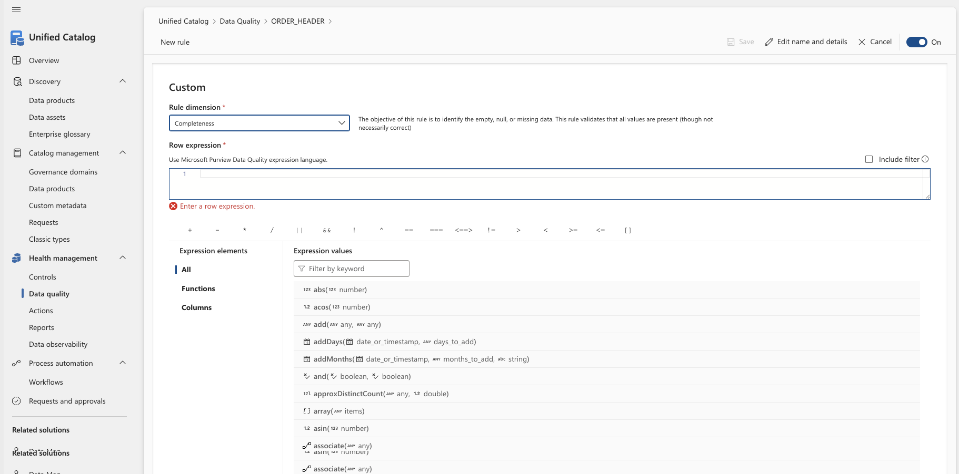

Slide 33
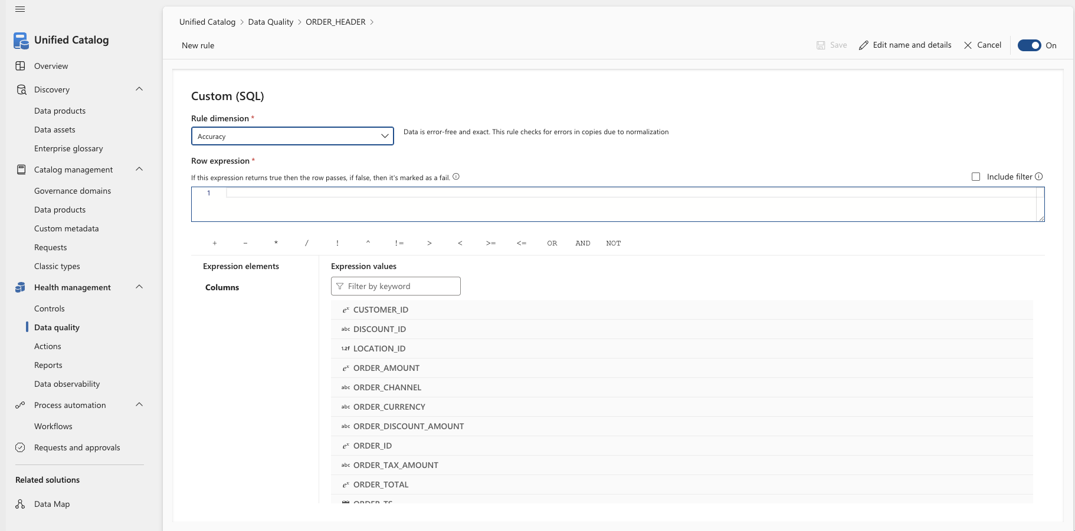

Slide 34
Policies

